Slide 1
HECON–Health Economics Research Center
Óbuda University
http://uni-obuda.hu/hecon
Formerly: Hungarian Office for Health Technology Assessment – HunHTA
12th July 2021

Slide 2
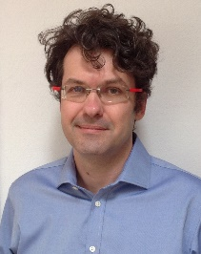
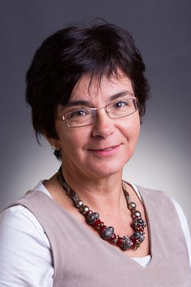
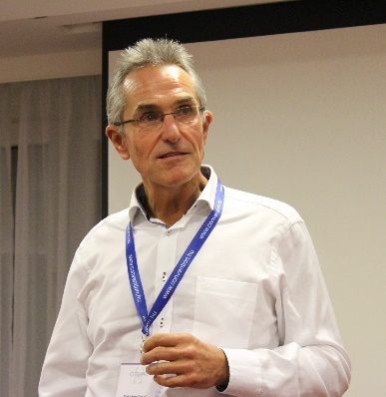
The HECON team
Zsombor Zrubka, MD, MBA, PhD
Head of Research Center
MTMT Google Scholar
e-mail: zrubka.zsombor@uni-obuda.hu
Prof. Márta Péntek MD, PhD, Habil.
MTMT Google Scholar
e-mail: pentek.marta@uni-obuda.hu
Prof. László Gulácsi MD, MSc, PhD, PhD, PhD, PhD, Habil., DSC
MTMT Google Scholar
e-mail: gulacsi@uni-obuda.hu
https://www.uni-obuda.hu/files/attachments/25274/hirmondo-2020-augusztus-116-szam.pdf

Slide 3
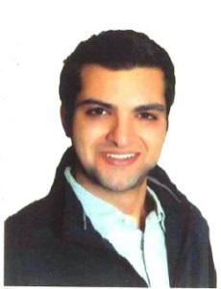

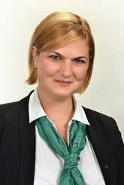
PhD students
Omar Rashdan, PharmD
supervisors Corvinus University of Budapest: Valentin Brodszky, Zsombor Zrubka
Óscar Brito Fernandes, MSc
supervisors, University of Amsterdam: Niek S. Klazinga, Dionne Kringos, Petra Baji, Márta Péntek, László Gulácsi
Petra Pogány
supervisor, Corvinus University of Budapest: Zsombor Zrubka

Slide 4


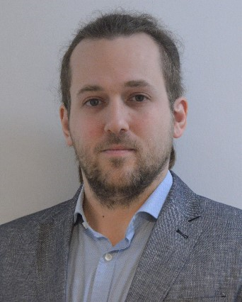
PhD students
Hossein Motahari-Nezhad
supervisor, Corvinus University of Budapest: Zsombor Zrubka
Dr. Irén Németh
supervisors, Corvinus University of Budapest: Márta Péntek, Zsombor Zrubka
Áron Hölgyesi
supervisor, Semmelweis University Budapest: Márta Péntek

Slide 5
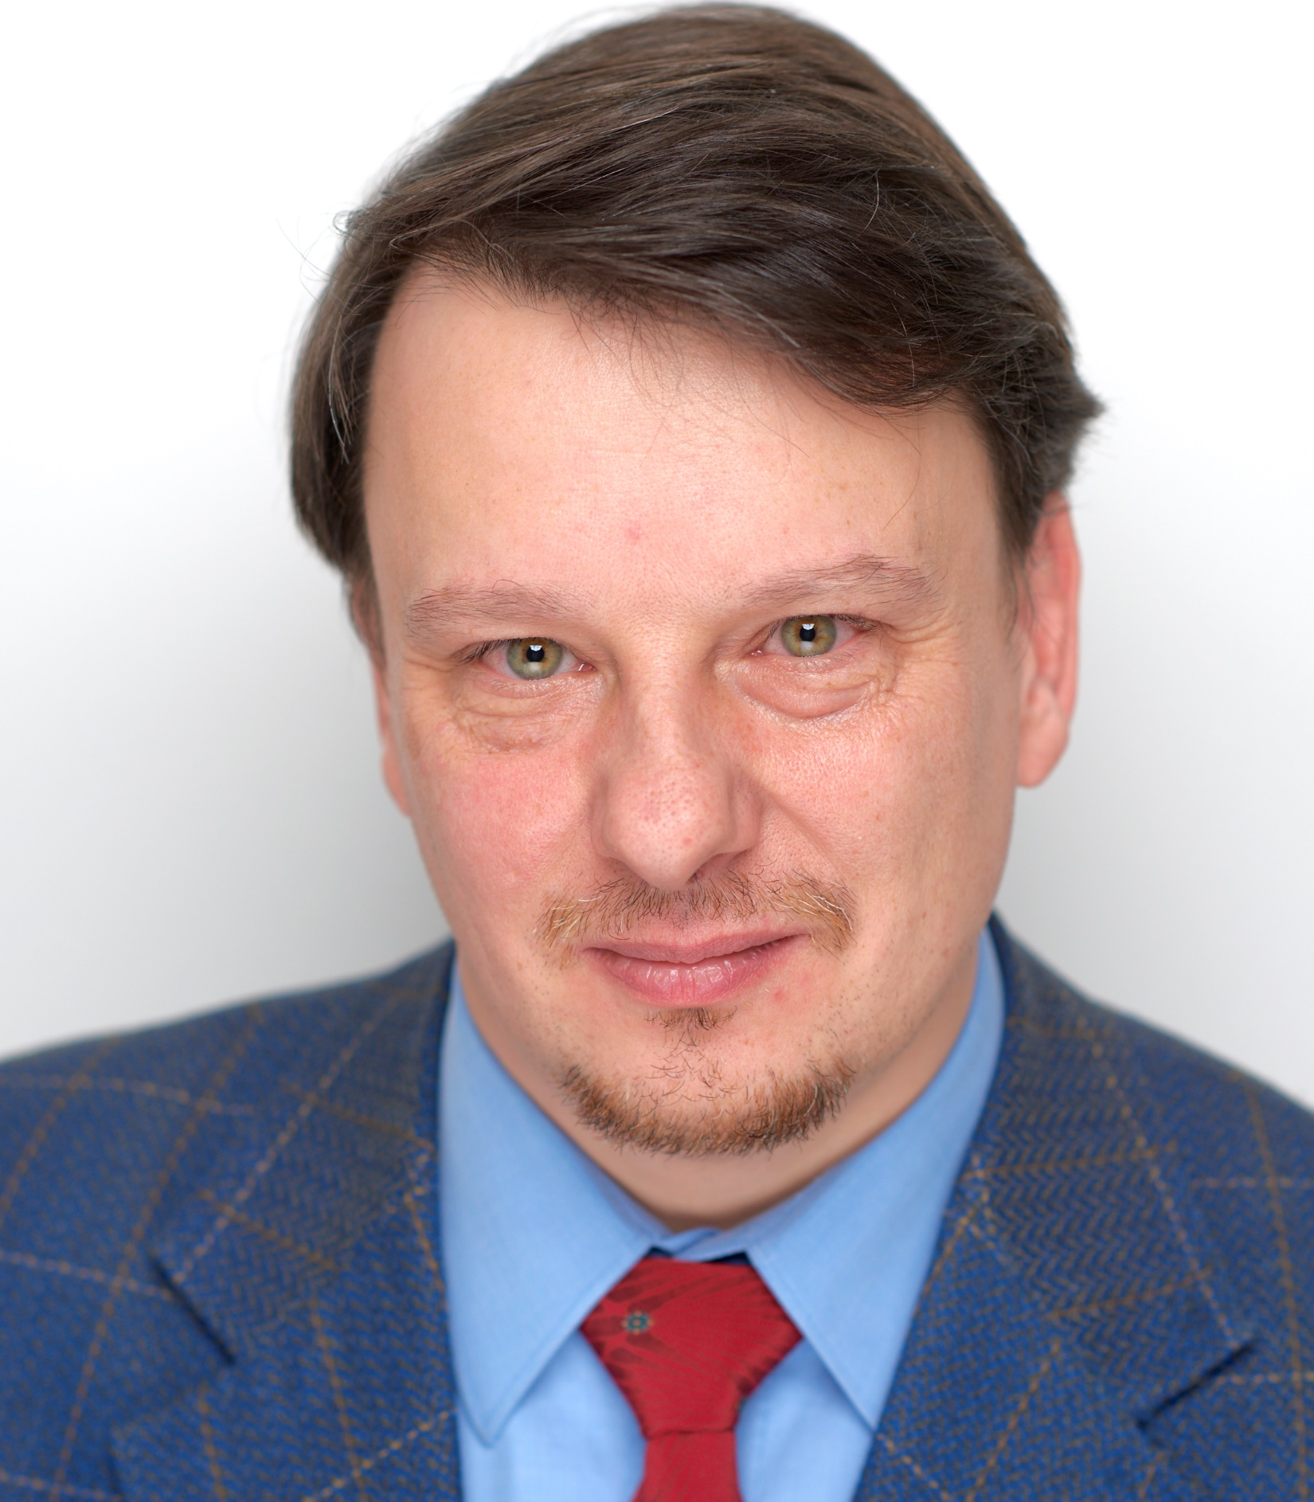

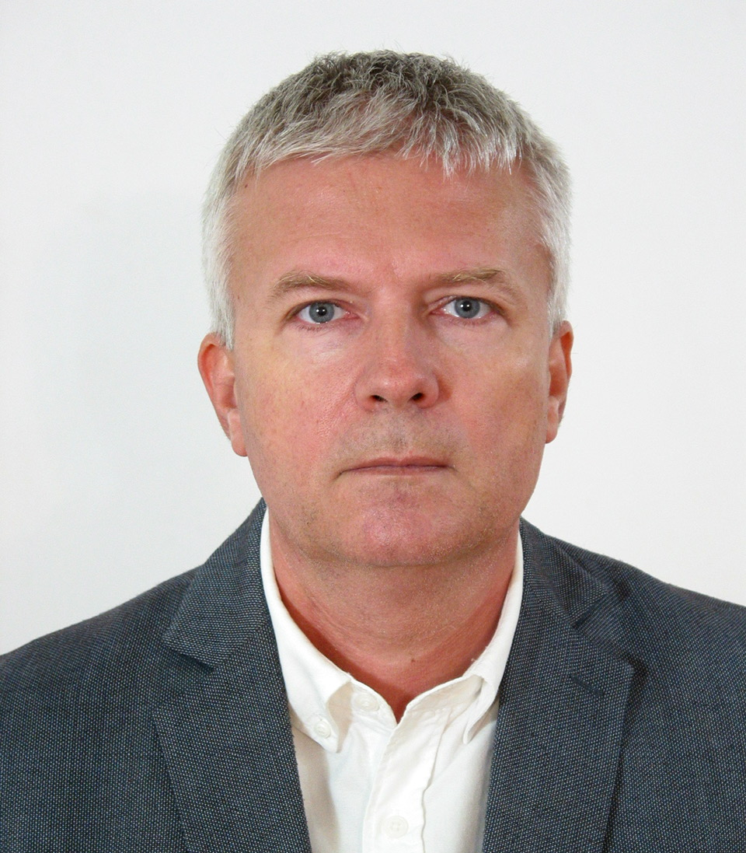

PhD students
Janos Czere
Supervisors, Óbuda University: Prof. Márta Péntek, Prof. László Gulácsi
Mariann Békésy
Supervisor, Óbuda University: Prof. László Gulácsi
Zsolt Debrenti
Supervisors, Óbuda University: Prof. László Gulácsi, Prof. József Fogarasi
Johanna Tripo
Supervisors, Óbuda University: Prof. Márta Péntek, Prof. József Fogarasi

Slide 6



PhD students
Barbara Tóth
supervisors, Óbuda University : Dr. Zsombor Zrubka, Dr. Péter Galambos
Meriem Fgaier
Supervisors, Óbuda University : Dr. Zsombor Zrubka, Prof. Márta Péntek
Lea Mhanna
Supervisors, Óbuda University : Dr. Zsombor Zrubka, Dr. Tamás Haidegger
Hana Al Abdulkarim
Supervisor, Óbuda University: Dr. Zsombor Zrubka

Slide 7



International Scientific Advisory Board
Prof. Dr. Niek Klazinga
Professor of Social Medicine, University of Amsterdam, The Netherlands; Senior policy advisor and lead of the work on Quality of Care, OECD
Prof. Werner B. F. Brouwer
Professor of Health Economics, Chairman, Erasmus School of Health Policy & Management, Erasmus University Rotterdam, The Netherlands
Prof. Job van Exel
Professor at the institute of Health Policy & Management (iBMG), Erasmus University Rotterdam, The Netherlands

Slide 8

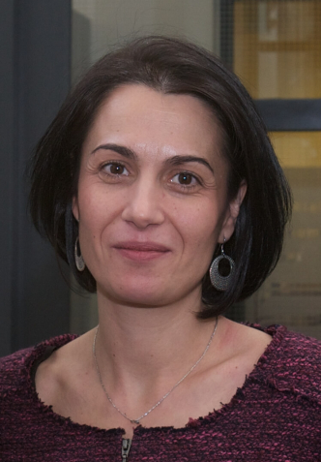

International Scientific Advisory Board
Prof. Beatriz González López-Valcárcel
University of Las Palmas, professor of Quantitative Methods in Economics, Spain
Prof. Milena Pavlova, PhD
Department of Health Services Research – Research School CAPHRI, Maastricht University, The Netherlands
Prof. Wolfgang Greiner
University of Bielefeld, professor of health economics, Germany

Slide 9
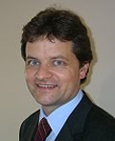

International Scientific Advisory Board
Valentina Prevolnik Rupel, PhD
Institute of Economic Research, Ljubljana, Slovenia
Prof. Dr. August Oesterle
Associate Professor of the Institute for Social Policy at Vienna University of Economics and Business, Austria
Prof. Dominik Golicki, MD, MA, PhD, Habil.
Department of Experimental & Clinical Pharmacology, Medical University of Warsaw, Poland

Slide 10


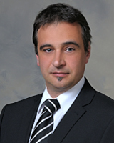

Hungarian Scientific Advisory Board
Prof. Dr. Imre Boncz
University of Pécs, Head of the Health Insurance Institute, Hungary
Petra Baji Ph.D. Habil.
Associate professor
Áron Kincses, Ph.D.
Deputy-President, Hungarian Central Statistical Office
György Balázs
EMKI-cert Orvostechnikai Eszközminősítő Kft

Slide 11
Public relations
59. Közgazdász vándorgyűlés – egészségügy- és egészségügy-gazdaságtani szekció, Gulácsi László, Az orvostechnikai eszközök piacra lépésének kihívásai az új EU-szabályozás tükrében, Magyar Közgazdasági Társaság 2021. https://www.youtube.com/watch?v=gJM1V66z4xE
Megalakult az új HECON – Egészségügyi Közgazdaságtan Kutatóközpont
http://news.uni-obuda.hu/articles/2020/10/06/megalakult-az-uj-hecon-egeszsegugyi-kozgazdasagtan-kutatokozpont
Beszéljünk az egészségről! Műveltség és kockázatok Dr. Zrubka Zsombor egészségügyi közgazdásszal
https://www.youtube.com/watch?v=dwWhGCrpHl8&fbclid=IwAR3zBzXHyCgURgl3Ce75SxfEB4fDACFhJ8N2QD-ACc4K7MJYXGhKJ240Czo
Kutatók éjszakája 2020 Bemutatkozik a HECON Egészségügyi Közgazdaságtan Kutatóközpont
https://www.youtube.com/watch?v=OuGz9hP-uQI&feature=youtu.be

Slide 12
Publications in English 2010 – 2021
2010 11 publications in peer reviewed journals IF: 25.946
2011 5 publications in peer reviewed journals IF: 8.911
2012 8 publications in peer reviewed journals IF: 13.800
2013 6 publications in peer reviewed journals IF: 9.700
2014 23 publications in peer reviewed journals IF: 49.675
2015 15 publications in peer reviewed journals IF: 29.909
2016 21 publications in peer reviewed journals IF: 76.358
2017 24 publications in peer reviewed journals IF: 70.270
2018 20 publications in peer reviewed journals IF: 29.206
2019 24 publications in peer reviewed journals IF: 80.470 (D1: 19, Q1: 2, Q2: 1 Q3: 1, Other: 1)
2020 22 publications in peer reviewed journals IF: 87.878 (D1: 8; Q1: 7; Q2: 3; Q3: 3, Other:1 )
2021 16 publications in peer reviewed journalsIF: 58.776 (D1: 3, Q1:3, Q2:5, Q3: -, Q4:3, Other: 2)

Slide 13
Publications in English 1/2021 Σ IF: 58.776
Óscar Brito Fernandes, Armin Lucevic, Márta Péntek, Dionne Kringos, Niek Klazinga, László Gulácsi, Zsombor Zrubka, Petra Baji, Self-Reported Waiting Times for Outpatient Health Care Services in Hungary: Results of a Cross-Sectional Survey on a National Representative Sample, Int. J. Environ. Res. Public Health 2021, 18, 2213. https://doi.org/10.3390/ijerph18052213 (International Journal of Envinromental Research and Public Health), 2021 Feb 24;18(5):2213 IF (2020) 3.39 Scimago Q2
Abstract: https://www.mdpi.com/1660-4601/18/5/2213
PDF Version: https://www.mdpi.com/1660-4601/18/5/2213/pdf
Katarzyna Kolasa, Francesca Mazzi, Ewa Leszczuk-Czubkowska, Zsombor Zrubka Márta Péntek, An Overview of Contact Tracing Applications Between Privacy Protection and Public Health: State-of-the-Art and Recommendations, JMIR mHealth and uHealth, 2021, 9 (6): 2703 (https://mhealth.jmir.org/2021/6/e23250#app7), IF (2020) 4.77 Scimago Q2
Annelies Boonen, Polina Putrik, Mary Lucy Marques, Alessia Alunno, Lydia Abasolo, Dorcas Beaton, Neil Betteridge, Mathilda Bjørk, Maarten Boers, Boryana Boteva, Bruno Fautrel, Francis Guillemin, Elsa F Mateus, Elena Nikiphorou, Márta Péntek, Fernando Pimentel Santos, Johan Severens, Suzanne M M Verstappen, Karen Walker-Bone, Johan Karlsson Wallman, Marieke M ter Wee, René Westhovens, Sofia Ramiro, EULAR Points to Consider (PtC) for designing, analysing and reporting of studies with work participation as an outcome domain in patients with inflammatory arthritis, Ann Rheum Dis 2021;0:1–8. doi:10.1136/annrheumdis-2020-219523, IF (2020) 19.103 Scimago D1
Hossein Motahari-Nezhad, Prof. Márta Péntek, Prof. László Gulácsi, dr. Zsombor Zrubka, Outcomes of digital biomarker-based interventions: protocol for a systematic review of systematic reviews, JMIR Research Protocols, accepted for publication 2021 Scimago Q4

Slide 14
Publications in English 2/2021 Σ IF: 58,776
Mihajlo Jakovljevic, Márta Péntek, Tissa Wijeratne, Guvenc Kockaya, Louis-François Pau, Editorial: [Accelerated Globalization and
its Impact to the World's Health Care Achievement], Frontiers in Public Health, 2021 Jun 7;9:690239, IF (2020) 3.709 Scimago Q2
Petra Baji, Miklós Farkas, Ágota Dobos, Zsombor Zrubka, Levente Kovács, László Gulácsi, Márta Péntek, Comparing the measurement properties of the ICECAP-A and ICECAP-O instruments in ages 50-70 – a cross sectional study on a representative sample of the Hungarian general population, European Journal of Health Economics, 2021, accepted for publication, , IF (2020) 3.689 Scimago D1
Gáspár K, Hunor Gergely L, Jenei B, Wikonkál N, Kinyó Á, Szegedi A, Remenyik É, Kiss N, Jin X, Sárdy M, Beretzky Z, Péntek M, Gulácsi L, Bánvölgyi A, Brodszky V, Rencz F. Resource utilization, work productivity and costs in patients with hidradenitis suppurativa: a cost-of-illness study. Expert Rev Pharmacoecon Outcomes Res. 2021 Mar 9:1-10. IF (2019): 2.217 Scimago Q2
Baji P, Brouwer WBF, van Exel J, Golicki D, Prevolnik Rupel V, Zrubka Z, Gulácsi L, Brodszky V, Rencz F, Péntek M., Validation of the Hungarian version of the CarerQol instrument in informal caregivers: results from a cross-sectional survey among the general population in Hungary. Quality of Life Research. 2021 Feb;30(2):629-641. doi: 10.1007/s11136-020-02662-8. Epub 2020 Oct 10., PMID: 33037979, IF (2019): 4.147 Scimago Q1
Josa V, Ferenczi S, Szalai R, Fuder E, Kuti D, Horvath K, Hegedus N, Kovacs T, Bagamery G, Juhasz B, Winkler Z, Veres DS, Zrubka Z, Mathe D, Baranyai Z., Thrombocytosis and Effects of IL-6 Knock-Out in a Colitis-Associated Cancer Model. International Journal of Molecular Sciences, 2020 Aug 27;21(17):6218. doi: 10.3390/ijms21176218, IF (2019): 5.923 Scimago Q1

Slide 15
Publications in English 3/2021 Σ IF: 58,776
Horváth T, Horváth B, Liktor B Jr, Zrubka Z, Liktor B, Risk stratification in endoscopic type I. tympanoplasty. Eur Arch Otorhinolaryngol. 2021 Jan 22. doi: 10.1007/s00405-021-06606-x. Online ahead of print, PMID: 33481078, IF (2020): 2.503 Scimago Q1
Irén Kopcsóné Németh, Márta Péntek, Zsombor Zrubka, Costs of infection control and special challenges during COVID-19 pandemic: experiences in a military hospital.. AARMS – Academic and Applied Research in Military and Public Management Science, accepted for publication
Miklós Farkas, Elisabeth Huynh, László Gulácsi, Zsombor Zrubka, Ágota Dobos, Levente Kovács, Petra Baji, Márta Péntek, Development of Population Tariffs for the ICECAP-A Instrument for Hungary and their Comparison to the UK Tariffs, Value in Health, accepted for publication, IF (2020): 5.725 Scimago D1
Márta Péntek, Gyula Poór, László Gulácsi, Zsombor Zrubka, Valentin Brodszky, Fanni Rencz, Ágota Dobos, Miklós Farkas, Levente Kovács, Petra Baji, Musculoskeletal health and capability wellbeing: associations between the HAQ-DI, ICECAP-A and ICECAP-O measures in a population survey,
Musculoskeletal Science and Practice, 55 (2021) 102420, https://doi.org/10.1016/j.msksp.2021.102420, IF (2020): 2.52 Scimago Q2

Slide 16
Publications in Hungarian 1/2021 Σ IF: 58.776
Zrubka Zsombor, Kincses Áron, Gilyán Csaba, Huber Anikó, Horváth Zsófia, Huszák Loretta, Tóth Barbara, Pogány Petra, Gulácsi László. A biotechnológia hazánkban [Biotechnology in Hungary], Statisztikai Szemle 2021. június, közlésre elfogadva
Zrubka Z, Kincses Á, Gulácsi L, Kovács L, Péntek M, Subjective expectations concerning life expectancy and age-related health burden., Orv Hetil. 2021 Jun 6;162(23):911-923. doi: 10.1556/650.2021.32124. PMID: 34091435 Hungarian. IF (2020): 0.540 Scimago Q4
Z Szilasi, V Jósa, Z Zrubka, T Mezei, K Merkel, F Helfferich, Z Baranyai, A magasabb vérlemezkeszám mint a fej-nyak tumoros betegek túléléssel kapcsolatos esetleges prognosztikai faktora, Orvosi Hetilap 162 (17), 676-682, IF (2020): 0.540 Scimago Q4

Slide 17
Publications in English 1/2020
V. Brodszky, B. Tamási, K. Hajdu , M. Péntek, A. Szegedi, M. Sárdy, Z. Bata-Csörgő, Á. Kinyó, L. Gulácsi, F. Rencz, Disease burden of patients with pemphigus; from a societal perspective, Expert Review of Pharmacoeconomics & Outcomes Research, 2021 Feb;21(1):77-86 Epub 2020 Jan 28. IF (2020) 2.217 Scimago Q2
Petra Baji, Miklós Farkas, Dominik Golicki, Valentina Prevolnik-Rupel, Renske Hoefman, Werner B.F. Brouwer, Job van Exel, Zsombor Zrubka, László Gulácsi, Márta Péntek, Development of population tariffs for the CarerQol instrument for Hungary, Poland and Slovenia – a discrete choice experiment study to measure the burden of informal caregiving, PharmacoEconomics, 2020, 38(6), 633-643, IF: 4.981 Scimago D1 DOI 10.1007/s40273-020-00899-2, http://link.springer.com/article/10.1007/s40273-020-00899-2
F. Rencz, H.L. Gergely, N. Wikonkál, K. Gáspár, M. Péntek, L. Gulácsi, B. Tamási, A.K. Poór, Á. Kinyó, G. Bali, B. Hidvégi, M. Sárdy, K. Hajdu, A. Szegedi, É. Remenyik, Z. Bata-Csörgő, P. Holló, P. Baji, V. Brodszky, Dermatology Life Quality Index (DLQI) score bands are applicable to DLQI-Relevant (DLQI-R) scoring, Journal of the European Academy of Dermatology and Venereology, 2020 Sep;34(9):e484-e486, First published: 03 April 2020, https://doi.org/10.1111/jdv.16398, IF: 6.166 Scimago D1
Suzanna Szilasi, Valéria Jósa, Zsombor Zrubka, Tünde Mezei, Tamás Vass, Keresztély Merkel, Frigyes Helfferich, Zsolt Baranyai , Neutrophil-To-Lymphocyte and Platelet-To-Lymphocyte Ratios as Prognostic Markers of Survival in Patients with Head and Neck Tumours—Results of a Retrospective Multicentric Study, Int. J. Environ. Res. Public Health 2020, 17, 1742. IF: 3.39 Scimago Q2

Slide 18
Publications in English 2/2020
Fanni Rencz, Valentin Brodszky, László Gulácsi, Dominik Golicki, Gábor Ruzsa, Simon Pickard, Ernest H. Law, Márta Péntek,
Parallel Valuation of the EQ-5D-3L and EQ-5D-5L by Time Trade-Off in Hungary. Value in Health, 2020,23(9):1235-1245 IF: 5.725 Scimago D1
Márta Péntek, Job van Exel, László Gulácsi, Valentin Brodszky, Zsombor Zrubka, Petra Baji, Fanni Rencz, Werner BF Brouwer, Acceptable health and ageing: results of a cross-sectional study from Hungary, Health and Quality of Life Outcomes, 2020 Oct 20;18(1):346. doi: 10.1186/s12955-020-01568-w. https://rdcu.be/b8NGp IF: 3.186 Scimago Q1,
L.H. Gergely, K. Gáspár, V. Brodszky, Á. Kinyó, A. Szegedi, É. Remenyik, N.F. Kiss, A. Bató, M. Péntek, L. Gulácsi, M. Sárdy, A. Bánvölgyi, N. Wikonkál, F. Rencz, Validity of EQ-5D-5L, Skindex-16, DLQI and DLQI-R in patients with hidradenitis suppurativa, Journal of the European Academy of Dermatology and Venereology, 2020 Nov;34(11):2584-2592. doi: 10.1111/jdv.16642. IF: 6.166 Scimago D1
Petra Baji, Miklós Farkas, Ágota Dobos, Zsombor Zrubka, László Gulácsi, Valentin Brodszky, Fanni Rencz, Márta Péntek, Capability of well-being: validation of the Hungarian version of the ICECAP-A and ICECAP-O questionnaires and population normative data. Quality of Life Research, 2020 Oct;29(10):2863-2874. doi: 10.1007/s11136-020-02542-1. IF: 4.147 Scimago Q1 (open access: https://link.springer.com/article/10.1007/s11136-020-02542-1)
Óscar Brito Fernandes, Márta Péntek, Dionne Kringos, Niek Klazinga, László Gulácsi, Petra Baji. Eliciting preferences for outpatient care experiences in Hungary: A discrete choice experiment with a national representative sample, PLoS One, 2020 Jul 31;15(7):e0235165. doi: 10.1371/journal.pone.0235165. eCollection 2020. IF: 3.24, Scimago D1

Slide 19
Publications in English 3/2020
Kringos D, Carinci F, Barbazza E, Bos V, Gilmore K, Groene O, Gulácsi L, Ivankovic D, Jansen, T, Johnsen SP, de Lusignan S, Mainz J, Nuti S, Klazinga N, Managing COVID-19 within and across health systems: why we need performance intelligence to coordinate a global response, Health Research Policy and Systems, 2020, 18(1):80. https://doi.org/10.1186/s12961-020-00593-x, https://rdcu.be/b5CIB, IF: 3.318 Scimago Q1
Zsombor Zrubka, Óscar Brito Fernandes, Petra Baji, Ottó Hajdu, Levente Kovács, Dionne Kringos, Niek Klazinga, László Gulácsi, Valentin Brodszky, Fanni Rencz, Márta Péntek, Exploring eHealth Literacy and Patient-Reported Experiences with Outpatient Care in the Hungarian General Adult Population: A Cross-Sectional Study, Journal of Medical Internet Research, 2020, 22(8):e19013. IF: 5.43 Scimago D1
Zsombor Zrubka, Omar Rashdan, László Gulácsi, Health Economic Publications From the Middle East and North Africa Region: A Scoping Review of the Volume and Methods of Research, Global Journal on Quality and Safety in Healthcare (2020) 3 (2): 44–54. https://doi.org/10.36401/JQSH-20-4, https://meridian.allenpress.com/innovationsjournals-JQSH/article/3/2/44/438321/Health-Economic-Publications-From-the-Middle-East
Fanni Rencz, Béla Tamási, Valentin Brodszky, Gábor Ruzsa, László Gulácsi, Márta Péntek, Did you get what you wanted? Patient satisfaction and congruence between preferred and perceived roles in medical decision-making in a Hungarian national survey, Value in Health Regional Issues, 2020 Sep;22:61-67. Scimago: Q1

Slide 20
Publications in English 4/2020
Meisters R, Putrik P, Ramiro S, Hifinger M, Keszei AP, van Eijk-Hustings Y, Woolf AD, Smolen JS, Stamm TA, Stoffer-Marx M, Uhlig T, Moe RH, de Wit M, Tafaj A, Mukuchyan V, Studenic P, Verschueren P, Shumnalieva R, Charalambous P, Vencovský J, Varvouni M, Kull M, Puolakka K, Gossec L, Gobejishvili N, Detert J, Sidiropoulos P, Péntek M, Kane D, Scirè CA, Arad U, Andersone D, van de Laar M, van der Helm-van Mil A, Głuszko P, Cunha-Miranda L, Berghea F, Damjanov NS, Tomšič M, Carmona L, Turesson C, Ciurea A, Shukurova S, Inanc N, Verstappen SM, Boonen A; Working group. EULAR/eumusc.net standards of care for rheumatoid arthritis: cross-sectional analyses of importance, level of implementation and care gaps experienced by patients and rheumatologists across 35 European countries. Ann Rheum Dis. 2020 Nov;79(11):1423-1431. doi: 10.1136/annrheumdis-2020-217520. IF: 19.103 Scimago: D1, https://ard.bmj.com/content/early/recent
Valeria Josa, Szilamer Ferenczi, Rita Szalai, Eniko Fuder, Daniel, Kuti, Krisztina Horvath, Nikolett Hegedus, Tibor J Kovacs, Gergo Bagamery, Balazs Juhasz, Zsuzsanna Winkler, Daniel S. Veres, Zsombor Zrubka, Domokos Máthé, Zsolt Baranyai, Thrombocytosis and effects of IL-6 knock-out in a colitis-associated cancer model, International Journal of Molecular Sciences 2020 Aug 27;21(17):E6218., IF: 5.923 Scimago D1
Márta Péntek, László Gulácsi, László Herszényi, János Banai, Károly Palatka, Péter L. Lakatos, Valentin Brodszky and Fanni Rencz, Subjective expectations regarding longevity and future health: A cross-sectional survey among patients with Crohn’s disease. Colorectal Disease, 2021 Jan;23(1):105-113. (Epub 2020 Oct 13.) doi:10.1111/codi.15357. IF (2020) 3.788 Scimago Q1

Slide 21
Publications in English 5/2020
Petra Baji, Werner B.F. Brouwer, Job van Exel, Dominik Golicki, Valentina Prevolnik Rupel, Zsombor Zrubka, László Gulácsi, Valentin Brodszky, Fanni Rencz, Márta Péntek, Validation of the Hungarian version of the CarerQol instrument in informal caregivers:
results from a cross-sectional survey among the general population in Hungary, Quality of Life Research 2021 Feb;30(2):629-641. (Epub 2020 Oct 10) doi: 10.1007/s11136-020-02662-8 Quality of Life Research IF (2020): 4.147, Scimago Q1
Csaba Oláh, Zsófia Kardos, Mónika Andrejkovics, Enikő Szarka, Katalin Hodosi, Andrea Domján, Mariann Sepsi, Attila Sas, László Kostyál, Katalin Fazekas, Ágnes Flórián, Katalin Lukács, Ágnes Miksi, Zsuzsanna Baráth, György Kerekes, Márta Péntek, Attila Valikovics, László Tamási, Dániel Bereczki, Zoltán Szekanecz, Assessment of cognitive function infemale rheumatoid arthritis patients: associations with cerebrovascular pathology,depression and anxiety, Rheumatology International, 2020 Apr;40(4):529-540,https://doi.org/10.1007/s00296-019-04449-8, IF: 2.631 Scimago Q2
Fernandes, Ó.B. ; Netshiombo, M. ; Gulácsi, L. ; Klazinga, N.S. ; Pentek, M. ; Baji, P., Patient experiences in a public primary health care clinic: A South African case study, SOCIETY AND ECONOMY 42 : 3 pp. 333-347. , 15 p. (2020) Scimago Q3
Anne Neubert, Óscar Brito Fernandes, Armin Lucevic, Milena Pavlova, László Gulácsi, Petra Baji, Niek Klazinga, Dionne Kringos, Understanding the use of patient-reported data by health care insurers: A scoping review. PLoS ONE 2020, 15(12): e0244546. https://doi.org/10.1371/journal.pone.0244546, IF: 3.24, Scimago Q1

Slide 22
Book chapters in English 2020
Bander Balkhi, Ali Alhammad, Laszlo Gulacsi, Chapter 3. ASSESSMENTS OF HEALTHCARE COSTS, in: (ed) Abdul Rahman Jazieh, Francisco Nuno Rocha Goncalves, Laszlo Gulacsi, Nada Abu-Shraie, Omar Da’ar, PHARMACOECONOMICS PRINCIPLES AND BEST PRACTICES:
A PRACTICAL GUIDE, 2020 Innovative Healthcare Institute, Cincinnati, OH, USA, All rights reserved. ISBN: 978-0-578-79396-2
Hana Al-Abdulkarim, Zsombor Zrubka, Chapter 4. GUIDELINES FOR PHARMACOECONOMIC EVALUATIONS, in: (ed) Abdul Rahman Jazieh, Francisco Nuno Rocha Goncalves, Laszlo Gulacsi, Nada Abu-Shraie, Omar Da’ar, PHARMACOECONOMICS PRINCIPLES AND BEST PRACTICES:
A PRACTICAL GUIDE, 2020 Innovative Healthcare Institute, Cincinnati, OH, USA, All rights reserved. ISBN: 978-0-578-79396-2

Slide 23
ISPOR Europe 2020 abstracts
Brodszky V, Mayer S, Konnopka A, Evers S, Hakkaart-van Roijen L, Salvador-Carulla L, Park AL, Hollingworth W, Simon J, Gulácsi L. PNS24 Standardized Unit Cost Calculation for Informal Care Time and CROSS-Country Comparison: PECUNIA Project. Value in Health. 2020;23:S647-S648. doi:10.1016/j.jval.2020.08.1468
Burrell A, Zrubka Z, Redekop K, Kolasa K, Vinuesa L, Zah V, Asche CV. PNS192 Defining the New Age of Digital Health? Results of a Systematic Scoping Literature Review. Value in Health. 2020;23:S673. doi:10.1016/j.jval.2020.08.1636
https://europe2020-ispor.ipostersessions.com/Default.aspx?s=96-7E-40-6B-33-8C-5B-C0-F9-EF-94-71-60-7B-04-29
Péntek M, Poór G, Brodszky V, Zrubka Z, Gulácsi L, Dobos Á, Farkas M, Baji P. PNS53 Population Normative DATA for the Health Assessment Questionnaire Disability INDEX in Hungary. Value in Health. 2020;23:S652. doi:10.1016/j.jval.2020.08.1497
Péntek M, Poór G, Dobos Á, Brodszky V, Zrubka Z, Gulácsi L, Farkas M, Baji P. PMS6 Validation of the Musculoskeletal Health Questionnaire (MSK-HQ) for Hungary: Results of an Online CROSS-Sectional Survey Among the General Population. Value in Health. 2020;23:S593. doi:10.1016/j.jval.2020.08.1137
Rashdan O, Brodszky V, Péntek M, Gulácsi L, Zrubka Z. PNS32 Towards a Healthcare Cost Catalogue for Middle EAST and North Africa: A Systematic Review of Productivity Loss Costs Reported in Health Economic Publications between 1989-2019. Value in Health. 2020;23:S649. doi:10.1016/j.jval.2020.08.1476
https://europe2020-ispor.ipostersessions.com/Default.aspx?s=C9-C4-10-A7-A1-53-1E-76-73-05-03-1A-40-00-35-D3

Slide 24
ISPOR Europe 2020 abstracts
Thema M, Rencz F, Péntek M, Brodszky V. PNS45 Monetary Valuation of a QALY Based on Demographics, Health Status, Income and Well-Being in Hungary. Value in Health. 2020;23:S651. doi:10.1016/j.jval.2020.08.1489
Zrubka Z, Abu-Zahra T, Almaaytah A, Péntek M, Gulácsi L. PNS38 Towards a Healthcare Cost Catalogue for Middle EAST and North Africa: A Systematic Review of Costs Reported in Health Economic Publications from Jordan, Lebanon Palestine and Syria 1995-2019. Value in Health. 2020;23:S650. doi:10.1016/j.jval.2020.08.1482
https://europe2020-ispor.ipostersessions.com/Default.aspx?s=02-D4-1D-7A-01-F7-57-72-95-D5-5F-C1-F3-38-15-ED
Zrubka Z, Alabdulkarim HAA, Péntek M, Gulácsi L. PNS34 Towards a Healthcare Cost Catalogue for Middle EAST and North Africa: A Systematic Review of Costs Reported in Health Economic Publications from the GULF Region 1995-2019. Value in Health. 2020;23:S649. doi:10.1016/j.jval.2020.08.1478
https://europe2020-ispor.ipostersessions.com/Default.aspx?s=33-B7-A9-F4-41-D3-3D-27-C6-1D-56-39-9A-D3-6B-3E
Zrubka Z, Burrell A, Asche CV, Vinuesa L, Zah V, Kolasa K, Redekop K. PNS195 Piloting a Comprehensive Search for Definitions of Digital Health in the Grey Literature: Preliminary Results from a Systematic Scoping Review. Value in Health. 2020;23:S673-S674. doi:10.1016/j.jval.2020.08.1639
https://europe2020-ispor.ipostersessions.com/Default.aspx?s=3F-24-A0-E1-F3-17-ED-6F-64-F3-47-6B-A9-91-AE-4A

Slide 25
ISPOR Europe 2020 abstracts
Zrubka Z, Fgaier M, Atitallah A, Mahdi Abid M, Péntek M, Gulácsi L. PNS19 Towards a Healthcare Cost Catalogue for Middle EAST and North Africa: A Systematic Review of Costs Reported in Health Economic Publications from Algeria, Libya, Morocco and Tunisia 1995-2019. Value in Health. 2020;23:S647. doi:10.1016/j.jval.2020.08.1463
https://europe2020-ispor.ipostersessions.com/Default.aspx?s=9F-83-F8-9C-E1-3D-CD-6A-B4-C2-99-B2-CE-28-8E-26
Zrubka Z, Mhanna L, Bassem Chmaissani M, Péntek M, Gulácsi L. PNS20 Towards a Healthcare Cost Catalogue for Middle EAST and North Africa: A Systematic Review of Costs Reported in Health Economic Publications from Egypt 1995-2019. Value in Health. 2020;23:S647. doi:10.1016/j.jval.2020.08.1464
https://europe2020-ispor.ipostersessions.com/Default.aspx?s=D3-89-0B-4F-07-6D-87-B0-4F-DA-B4-06-92-C6-94-E2
Zrubka Z, Vékás P, Németh P, Dobos Á, Hajdu O, Kovács L, Péntek M, Gulácsi L. PNS251 Psychometric Properties of the Hungarian Language Version of the 13-ITEM Patient Activation Measure (PAM-13) in an Online Sample of the Adult General Population. Value in Health. 2020;23. doi:10.1016/j.jval.2020.08.1695
https://europe2020-ispor.ipostersessions.com/Default.aspx?s=F5-67-16-AF-55-EB-42-9A-CE-8D-A6-FD-31-29-2D-4E

Slide 26
Publications in Hungarian 2020
Péntek Márta dr., Beretzky Zsuzsanna, dr., Brodszky Valentin Szabó Attila dr., Kovács Levente, Kincses Áron dr., Baji Petra, Zrubka Zsombor dr., Rencz Fanni dr., Gulácsi László dr., A magyarországi lakosság egészséggel összefüggő munkaképessége: keresztmetszeti reprezentatív felmérés a Munkaképességre és Tevékenységcsökkenésre vonatkozó kérdőívvel [Health-related productivity of the Hungarian population. A cross-sectional survey], Orvosi Hetilap 2020 Sep;161(36):1522-1533, IF: Scimago Q3
Zrubka Zsombor, Dr. Kincses Áron, Gulácsi László, Kovács Levente, Péntek Márta, Az élettartammal és időskori betegségteherrel kapcsolatos szubjektív várakozások, Orvosi Hetilap 2021, 162 (23): 911-923 (accepted for publication: 29 December, 2020), IF (2020): 0.497 Scimago Q3

Slide 27
Conference presentations in English 2020
Corvinus Health Policy and Health Economics Conference Series 2020/1 The value of digital health - Is health economics ready for digital transformation? February 25th, 2020 Corvinus University of Budapest, 2020
Conference chairperson: Prof. Márta Péntek
Zsombor Zrubka, Patient-reported outcomes in digital health
Petra Baji, László Gulácsi, Setting up an HTA study in different context, Open Medical Institute OMINAR, Economic Evaluation in Healthcare, November 25-26, 2020, Sazburg, Ausztria - Organized by ASPHER Working Group on Economic Evaluation in Healthcare in Europe and Maastricht University, School for Public Health and Primary Care (CAPHRI)
Zsombor Zrubka, László Gulácsi: Health Outcomes Measurement in Economic Evaluation 2nd International Pharmacoeconomics Forum, 13-14th November 2020, Riyadh
Gulácsi László, The role of Pharmacoeconomics in approval of new medications, Evidence Based Medicine and Health Economics Application in the Healthcare system in Jordan, December 10, 2020, Amman, Jordan, Fairmont Hotel
Gulácsi László, The tools for Pharmacoeconomics application in pricing, Evidence Based Medicine and Health Economics Application in the Healthcare system in Jordan, December 10, 2020, Amman, Jordan, Fairmont Hotel

Slide 28
Conferences in Hungarian 2020
Gulácsi László, A költség-haszon elemzések célja, története, módszertana; EU-OSHA új módszertani koncepciója, 2020. március 12.
Az Innovációs és Technológiai Minisztérium (ITM) Munkavédelmi Főosztály EU-OSHA Nemzeti Fókuszpont
http://www.ommf.gov.hu/index.php?akt_menu=540&hir_reszlet=731
Dr. Zrubka Zsombor, Az egészségügyben megvalósított beavatkozások megtérülése; fenntartható foglalkoztatás; társadalmi hatások, 2020. március 12. Az Innovációs és Technológiai Minisztérium (ITM) Munkavédelmi Főosztály EU-OSHA Nemzeti Fókuszpont
http://www.ommf.gov.hu/index.php?akt_menu=540&hir_reszlet=731
Dr. Zrubka Zsombor, A digitális intervenciók társadalmi és gazdasági haszna, Digital Health Summit, 2020. febr 27. BMC (Budapest Music Center)
Gulácsi László, Az egészségügyi technológiaelemzés szerepe a társadalmi szintű haszon optimalizálásában, Congressus Pharmaceuticus Hungaricus XVI. Ülés, Klinkkai vizsgálatok, biológiai gyógyszerfejlesztés, 2020. szetember. 10. Debrecen.
Péntek Márta, Poór Gyula, Dobos Ágota, Brodszky Valentin, Zrubka Zsombor, Baji Petra, Gulácsi László, A Musculoskeletal Health Questionnaire (MSK-HQ) mérce magyar verziójának validálása lakossági felmérés keretében. Magyar Reumatológusok Egyesülete Vándorgyűlése, online, 2020, október 16.
Péntek Márta, Poór Gyula, Zrubka Zsombor, Gulácsi László, Dobos Ágota, Farkas Miklós, Baji Petra. Lakossági normaértékek a Health Assessment Questionnaire Disability Index (HAQ-DI) mércével Magyarországon. (poszterelőadás). Magyar Reumatológusok Egyesülete Vándorgyűlése, online, 2020, október 16.
Gulácsi László, Népbetegségek statisztikai követése, MKT-MTT Kardiopulmonális Szekció 24. ülése és MTT Légzésrehabilitációs Szekcióülés, 2020. november 16-20. 18:00 – 20:00

Slide 29
Publications in English 1/2019
László Gulácsi, Zsombor Zrubka, Valentin Brodszky, Fanni Rencz, Rieke Alten, Zoltán Szekanecz, and Márta Péntek, Long-Term Efficacy of Tumor Necrosis Factor Inhibitors for the Treatment of Methotrexate-Naïve Rheumatoid Arthritis: Systematic Literature Review and Meta-Analysis, Advances in Therapy, 2019 Mar;36(3):721-745. First http://link.springer.com/article/10.1007/s12325-018-0869-8, IF: 3.871 Scimago Q1
Rencz, F; Lakatos, PL; Gulácsi, L; Brodszky, V; Kürti, Z ; Lovas, S ; Banai, J ; Herszényi, L ; Cserni, T ; Molnár, T, Péntek M, Palatka K, Validity of the EQ-5D-5L and EQ-5D-3L in patients with Crohn’s disease, Quality of Life Research 28 : 1 pp. 141-152. , 12 p. (2019), IF: 2.773 Scimago Q1
F Rencz, V Brodszky, L Gulácsi, M Péntek, AK Poór, P Holló, A Szegedi, É Remenyik, M Sárdy, A Langenbruch, MA Radtke, M Gutknecht, M Augustin, Time to revise the DLQI scoring in psoriasis treatment guidelines, 2019 Jul;33(7):e267-e269. Journal of the European Academy of Dermatology & Venereology, IF: 5.248 Scimago D1
Laszlo Gulacsi, Marta Pentek, Fanni Rencz, Valentin Brodszky, Petra Baji, Zsuzsanna Vegh, Krisztina B Gecse, Silvio Danese, Laurent Peyrin-Biroulet, Peter L. Lakatos, Biosimilars for the Management of Inflammatory Bowel Diseases: Economic Considerations, Current Medicinal Chemistry, 2019;26(2):259-269., DOI : 10.2174/0929867324666170406112304, IF: 4.184 Scimago D1
Kamilla Koszorú, Júlia Borza, László Gulácsi, Miklós Sárdy, Quality of life of patients suffering from atopic dermatitis, Cutis 2019 September;104(03):174-177 IF: 0.470 Scimago Q3

Slide 30
Publications in English 2/2019
The European Journal of Health Economics
Volume 20, Issue 1 Supplement, June 2019
Patient-reported outcomes: opportunities and challenges in Central Europe
Issue Editor: Márta Péntek
ISSN: 1618-7598 (Print) 1618-7601 (Online)
In this issue (15 articles)
Journal website
Márta Péntek, Patient‑reported outcomes: opportunities and challenges in Central Europe, The European Journal of Health Economics (2019) 20 (Suppl 1):S1–S3, IF: 2.367 Scimago D1 (open access)
Petra Baji, Dominik Golicki, Valentina Prevolnik-Rupel, Werner B.F. Brouwer, Zsombor Zrubka, László Gulácsi, Márta Péntek, The burden of informal caregiving in Hungary, Poland and Slovenia– results from national representative surveys, The European Journal of Health Economics (2019) 20 (Suppl 1):S5–S16, IF: 2.367 Scimago D1 (open access)
Márta Péntek, Ottó Hajdu, Fanni Rencz, Zsuzsanna Beretzky, Valentin Brodszky, Petra Baji, Zsombor Zrubka, Klára Major, László Gulácsi, Subjective expectations regarding ageing: a cross‑sectional online population survey in Hungary, The European Journal of Health Economics (2019) 20 (Suppl 1):S17–S30, IF: 2.367 Scimago D1 (open access)

Slide 31
Publications in English 3/2019
Zsombor Zrubka, Zoltán Hermann, László Gulácsi, Valentin Brodszky, Fanni Rencz, Márta Péntek, Determinants of the acceptability of health problems in different ages: exploring a new application of the EQ VAS, The European Journal of Health Economics (2019) 20 (Suppl 1):S31–S41, IF: 2.367 Scimago D1 (open access)
Fanni Rencz, Béla Tamási, Valentin Brodszky, László Gulácsi, Miklós Weszl, Márta Péntek, Validity and reliability of the 9‑item Shared Decision Making Questionnaire (SDM‑Q‑9) in a national survey in Hungary, The European Journal of Health Economics (2019) 20 (Suppl 1):S43–S55, IF: 2.367 Scimago D1 (open access)
Zsombor Zrubka, Ottó Hajdu, Fanni Rencz, Petra Baji, László Gulácsi, Márta Péntek, Psychometric properties of the Hungarian version of the eHealth Literacy Scale, The European Journal of Health Economics (2019) 20 (Suppl 1):S57–S69 IF: 2.367 Scimago D1 (open access)
Armin Lucevic, Márta Péntek, Dionne Kringos, Niek Klazinga, László Gulácsi, Óscar Brito Fernandes, Imre Boncz, Petra Baji, Unmet medical needs in ambulatory care in Hungary: forgone visits and medications from a representative population survey, The European Journal of Health Economics (2019) 20 (Suppl 1):S71–S78, IF: 2.367 Scimago D1 (open access)
Óscar Brito Fernandes, Petra Baji, Dionne Kringos, Niek Klazinga, László Gulácsi, Armin Lucevic, Imre Boncz, Márta Péntek, Patient experiences with outpatient care in Hungary: results of an online population survey, The European Journal of Health Economics (2019) 20 (Suppl 1):S79–S90 , IF: 2.367 Scimago D1 (open access)

Slide 32
Publications in English 4/2019
Fanni Rencz, Peep F. M. Stalmeier, Márta Péntek, Valentin Brodszky, Gábor Ruzsa, Lóránt Gönczi, Károly Palatka, László Herszényi, Eszter Schäfer, János Banai, Mariann Rutka, László Gulácsi, Peter L. Lakatos, Patient and general population values for luminal and perianal fistulising Crohn’s disease health state, The European Journal of Health Economics(2019) 20 (Suppl 1):S91–S100, IF: 2.367 Scimago D1 (open access)
Ariel Mitev, Fanni Rencz, Béla Tamási, Krisztina Hajdu, Márta Péntek, László Gulácsi, Andrea Szegedi, Zsuzsanna Bata-Csörgő, Ágnes Kinyó, Miklós Sárdy, Valentin Brodszky, Subjective well‑being in patients with pemphigus: a path analysis, European Journal of Health Economics (2019) 20 (Suppl 1):S101–S107, IF: 2.367 Scimago D1 (open access)
Valentina Prevolnik Rupel, Marko Divjak, Zsombor Zrubka, Fanni Rencz, László Gulácsi, Dominik Golicki, Dagmara Mirowska-Guzel, Judit Simon, Valentin Brodszky, Petra Baji, Jakub Závada, Guenka Petrova, Alexandru Rotar, Márta Péntek, EQ-5D studies in nervous system diseases in eight Central and East European countries: a systematic literature review, The European Journal of Health Economics (2019) 20 (Suppl 1):S109–S117, IF: 2.367 Scimago D1
Zsombor Zrubka, Zsuzsanna Beretzky, Zoltán Hermann, Valentin Brodszky, László Gulácsi, Fanni Rencz, Petra Baji, Dominik Golicki, Valentina Prevolnik‑Rupel, Márta Péntek, A comparison of European, Polish, Slovenian and British EQ‑5D‑3L value sets using a Hungarian sample of 18 chronic diseases, The European Journal of Health Economics (2019) 20 (Suppl 1):S119–S132, IF: 2.367 Scimago D1 (open access)

Slide 33
Publications in English 5/2019
Zsombor Zrubka, Dominik Golicki, Valentina Prevolnik‑Rupel, Petra Baji, Fanni Rencz, Valentin Brodszky, László Gulácsi, Márta Péntek, Towards a Central‑Eastern European EQ‑5D‑3L population norm: comparing data from Hungarian, Polish and Slovenian population studies, The European Journal of Health Economics (2019) 20 (Suppl 1):S141–S154, IF: 2.367 Scimago D1, (open access)
Valentin Brodszky, Zsuzsanna Beretzky, Petra Baji, Fanni Rencz, Márta Péntek, Alexandru Rotar,
Konstantin Tachkov, Susanne Mayer, Judit Simon, Maciej Niewada, Rok Hren, László Gulácsi, Cost‑of‑illness studies in nine Central and Eastern European countries, The European Journal of Health Economics (2019) 20 (Suppl 1):S155–S172, IF: 2.367 Scimago D1 (open access)
K. Hajdu, V. Brodszky, P.F.M Stalmeier, G. Ruzsa, B. Tamási, L. Gulácsi, M. Péntek, M. Sárdy, Z. Bata-Csörgő, Á. Kinyó, A. Szegedi, F. Rencz, Patient-assigned health utility values for controlled and uncontrolled pemphigus vulgaris and foliaceus, Journal of the European Academy of Dermatology and Venereology, 2019 Nov;33(11):2106-2113. doi: 10.1111/jdv.15765. IF: 5.248 Scimago D1 (accepted for publication)
Zsombor Zrubka, László Gulácsi, Valentin Brodszky, Fanni Rencz, Rieke Alten, Zoltán Szekanecz, and Márta Péntek, Long-term efficacy and cost-effectiveness of infliximab as first-line treatment in rheumatoid arthritis: systematic review and meta-analysis, Expert Review of Pharmacoeconomics & Outcomes Research, 2019 Oct;19(5):537-549. DOI/MS ID: 10.1080/14737167.2019.1647104 /, IF: 2.032 Scimago Q2 (open access)

Slide 34
Publications in English 6/2019
Jazieh AR, Pizzo E, Gulacsi L, Eldahiyat F, Abu-Helalah M, AlAbdulkareem H, Maraiki F, AlSaggabi A, Cornes P, Implementation of Country-Wide Pharmacoeconomic Principles in Cancer Care in Developing Countries, Global Journal on Quality and Safety in Healthcare. (2019) 2 (4): 109–114. Available from: http://www.jqsh.org/preprintarticle.asp?id=266840
Polina Putrik, Sofia Ramiro, Francis Guillemin, Márta Péntek, Francisca Sivera, Tuulikki Sokka, Maarten de Wit, Anthony d Woolf, Angela Zink, Daina Andersone, Florian Berghea, Irena Butrimiene, Sandra Brouwer, Karen Cassar, Paraskevi Charalambous, Roberto Caporali, Elena Deseatnicova, Nemanja s Damjanov, Axel Finckh, Oliver Fitzgerald, Gerður Gröndal, Nino Gobejishjvili, Piotr Głuszko, Marco Hirsch, Igor Jovanovic, Jiří Vencovský, Xavier Janssens, Andras Keszei, Maria Kovarova, Mart Kull, Luís Cunha Miranda, Miroslav Mayer, Snezana Percinkova, Nevsun Inanc, Oleg Nadashkevitz, Ingemar F Petersson, Kari Puolakka, Bernadette Rojkovich, Helga Radner, Fruzsina Szabados, Gleb Slobodin, Ivan Shirinsky, Nikolay Soroka, Prodromos Sidiropoulos, Russka Shumnalieva, Sekib Sokolovic, Surayo Shukurova, Argjend Tafaj, Matija Tomšič, Till Uhlig, Suzanne M Verstappen, Annelies Boonen, Patients with rheumatoid arthritis facing sick leave or work disability meet varying regulations: a study among rheumatologists and patients from 44 European countries, Ann Rheum Dis 2019 Nov;78(11):1472-1479. doi:10.1136/ annrheumdis-2019-215294, IF: 16.102 Scimago D1
F. Rencz, L. Gulácsi, M. Péntek, A. Szegedi, É. Remenyik, Z. Bata-Csörgő, G. Bali, B. Hidvégi, B. Tamási, A.K. Poór, K. Hajdu, P. Holló, Á. Kinyó, M. Sárdy, V. Brodszky, DLQI-R scoring improves the discriminatory power of Dermatology Life Quality Index in psoriasis, pemphigus and morphea patients, British Journal of Dermatology, 2020 May;182(5):1167-1175. IF: 7.0 Scimago D1

Slide 35
Ongoing research projects
Funded by the European Commission (H–2020)
HealthPros -Healthcare Performance Intelligence Professionals, Marie Sklodowska-Curie Innovative Training Network for Healthcare Performance Intelligence Professionals, 2018 – 2022, Project leader in Hungary: Petra Baji PhD habil., Prof. László Gulácsi, Budget (Hungary): 404 627 euro. https://www.healthpros-h2020.eu/index.php
PECUNIA -Programme in Costing, resource use measurement and outcome valuation for Use in multi-sectoral National and International health economic evaluations, 2018 – 2022, Project leader in Hungary: Prof. Valentin Brodszky, Prof. László Gulácsi, Budget (Hungary) 89 270 euro, https://www.pecunia-project.eu/about/consortium
Hungarian
FIKP – Felsőoktatási Intézményi Kiválósági Program (2018-2021) Higher Education Institutional Excellence Program of the Ministry of Human Capacities in the framework of the ‘Financial and Public Services’ research Project (20764-3/2018/FEKUTSTRAT) at Corvinus University of Budapest: ‘Healthcare and social burden: current and future costs, need for and evaluation of innovations ’ subproject. Project leaders: Prof. Márta Péntek (1st year), Prof. Valentin Brodszky (2nd year) TTKP – Tématerületi Kiválóság Program (2019-2021)
TTKP - Nemzeti Kutatási, Fejlesztési és Innovációs Hivatal Tématerületi Kiválóság Program: Az innováció potenciálja, formái, társadalmi és gazdasági haszna a digitalizálódó társadalomban. Alprojekt: Az innovációk társadalmi és gazdasági hasznosulása: digitalizáció és egészségipar. National Research, Development and Innovation Fund of Hungary Thematic Execellence Program: The potential, forms, societal and economic benefits of innovation in the society under digital transformation. Subproject: Societal and economic benefits of innovation: digitalisation and the life-sciences industry. Subproject lead: Prof. László Gulácsi, Project coordinator: dr. Zrubka Zsombor

Slide 36
Completed EU-funded research projects
COMAC/HSR – Concerted Action Programme on Quality Assurance in European Hospitals (1992-1994)
BIOMED/PECO – Co-operation in Science and Technology with Central and Estern European Countries and with the New Independent States of the Former Soviet Union, Les Pays d'Europe Centrale et Orientale, (BIOMED/PECO)' of the EU, DG XII (1994-1997)
DERMA (IST-1999-20226) – “Prototypal system - based on image acquisition, 3D and chromatic reconstruction - for the objective monitoring of skin lesions”, V Framework Programme: Information, Society Technologies (1999-2003)
ENQual – Exchange of knowledge on research methods to assess Quality Management in health care organisations in European countries, in relation to the National Quality Policy in each country), Framework Programme (2002-2004)
CEEQNET – Central and Eastern Europe Quality Network, Directorate C - Public Health and Risk Assessment, Health & Consumer Protection, Directorate general (2004-2006)
EuroCoDe – European Collaboration on Dementia (Project: A/790609 – EuroCoDe), EC / DG Sanco (2006-2009)
EUNetHTA – European Network for Health Technology Assessment, EC / DG Sanco (2006-2009)
EuroVaQ – European Value of a Quality Adjusted Life Year (2007 – 2010) http://research.ncl.ac.uk/eurovaq/
EURHOMAP – Mapping Professional Home Care in Europe (2007 – 2011)
ASSPRO CEE 2007 – Assessment of patient payment policies and projection of their efficiency, equity and quality effects. The case of Central and Eastern Europe (2008 – 2013) http://www.assprocee2007.com/
H&W – Health at Work (2009 – 2013)
BURQOL-RD – Social and economic burden and health-related quality of life in patients with rare diseases in Europe (2010 – 2013)
http://www.burqol-rd.com/

Slide 37
Research competences: Clinical areas
Rheumatology
Immun-mediated chronic inflammatory diseases
  rheumatoid arthritis (RA)
  Ankylosing spondylitis (AS)
  psoriatic arhritis (PsA)
  systemic sclerosis (SSc)
Osteoporosis
Brain and mental disorders
dementia
multiple sclerosis (MS)
epilepsy
Parkinson’s disease
attention deficit and hyperactivity disorder (ADHD)
schizophrenia
Dermatology
psoriasis,
pemphigus,
alopecia,
hidradenitis suppurativa (HS)
atopic dermatitis
Gastroenterology
Inflammatory bowel diseases (IBD)
  Crohn’s disease (CD)
  Ulcerative colitis (UC)
Pain
migraine
dysmenorrhea
Oncology
bladder cancer
prostate cancer
non-Hodgkin's lymphoma (NHL)
chronic lymphocytic leukemia (CLL)
Urology
urinary incontinence,
benign prostate hyperplasia (BPH)
Rare diseases

Slide 38
Research areas / methods
Health Technology Assessment (HTA)
40 full HTAs completed and 25 published
Analysis and synthesis of scientific evidence
Syetematic reviews and meta-analyses
Health economic / pharmacoeconomic evaluation
Cost effectiveness / cost utility modelling
Budget impact modelling
Measuring outcomes and costs of disease
Patient surveys
Surveys in the general population
Expert / physician surveys
Contingent valuation (willingness to pay studies)
Costing / resource use studies
Measuring societal impact (productivity loss, caregiver burden)
Developing methods and instruments for the measurement of health, quality of life, health-related behaviours and attitudes
Validation / linguistic adaptation of questionnaires
National norms
Crosswalk algorithms between instruments
Quality of life valuation
Other areas in health policy and healthcare management
Patient access
International HTA, international transferability of HTA results
Quality improvement
infection control
Patient payment policy
Non-technological innovation

Slide 39

Prof. László Gulácsi MD, MSc, PhD, PhD, PhD, PhD, Habil., DSC
Research areas / PhD topics
Health Economics, Health Technology Assessment & Medical Decision Making
Pharmacoeconomics: biological, biosimilar and chemical drugs
Medical devices: from clinical evidence to cost-effectiveness
Outcome evaluation & quality of life
Disease burden & cost of illness in acute and chronic diseases
Value based purchasing, quality improvement and pay for performance
Health service research, health policy and financing
Economics and innovation of health industry
Digital Health Technology
Occupational health economics and health status related sustainable employment
PhD supervision
Doctoral School in Business and Management, Corvinus University of Budapest
Doctoral School of Clinical Medicine, Semmelweis University
University of Amsterdam, Academic Medical Center, Amsterdam

Slide 40
Prof. Márta Péntek MD, PhD, Habil.
Research areas / PhD topics
Outcome measurement and evaluation in healthcare
Patient reported outcome measures (PROM)
Patient reported experience measures (PREM)
Outcome measures for use in economic evaluations
Validation of health-related quality of life and wellbeing measures
Subjective expectations regarding longevity and future health: studies among the general
population and in chronic diseases
Informal care: care related quality of life of informal caregivers
Health economics of rheumatic diseases
PhD supervision
Doctoral School in Business and Management, Corvinus University of Budapest
Doctoral School of Clinical Medicine, Semmelweis University
University of Amsterdam, Academic Medical Center, Amsterdam

Slide 41
Zsombor Zrubka, MD, MBA, PhD
Research areas / PhD topics
Digital health
Patient-reported outcomes, patient-reported experiences
Patient activation, patient engagement
Health literacy, eHealth literacy
Acceptable health problems
Subjective health expectations
Evidence synthesis
Health economic modelling
Innovation in the life-sciences industries
PhD supervision
Doctoral School in Business and Management, Corvinus University of Budapest

